Slide 1
Determining Slopes of Perpendicular Lines
Algebra I | Module 2 | Topic 2 | Lesson 3
1
Notes:
Note: Total suggested pacing for this lesson is two 45-minute sessions.

Slide 2
Objectives
Identify and write the equations of lines perpendicular to
given lines.
Identify and write the equations of horizontal and vertical lines.
SE p. 305
2
Notes:
TEKS:
A.1D: communicate mathematical ideas, reasoning, and their implications using multiple representations, including symbols, diagrams, graphs, and language as appropriate.
A.1E: create and use representations to organize, record, and communicate mathematical ideas.
A.2F: write the equation of a line that contains a given point and is perpendicular to a given line.
A.2G: write an equation of a line that is parallel or perpendicular to the x- or y-axis and determine whether the slope of the line is zero or undefined.
ELPS:
2.I: demonstrate listening comprehension of increasingly complex spoken English by following directions, retelling or summarizing spoken messages, responding to questions and requests, collaborating with peers, and taking notes commensurate with content and grade-level needs.
3.E: share information in cooperative learning interactions.
4.K: demonstrate English comprehension and expand reading skills by employing analytical skills such as evaluating written information and performing critical analyses commensurate with content area and grade-level needs.

Slide 3
Essential Question (1 of 2)
You have translated the graphs of linear equations to determine the slopes of parallel lines.
How can you rotate the graphs of linear equations to determine the slopes of perpendicular lines?
SE p. 305
3
Notes:
Setting the Stage:
Tap into your student’s prior learning by reading the narrative statement.
Provide a sense of direction by reading the Essential Question.

Slide 4
Day 1
1
4
Notes:
Note: Total suggested pacing for Day 1 is 45 minutes.

Slide 5
Getting Started
15–20
5
Notes:
Note: Total time of 15-20 minutes allotted for the Getting Started.

Slide 6
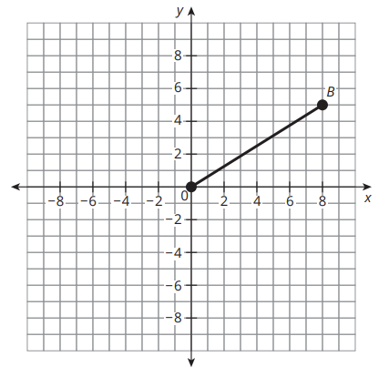
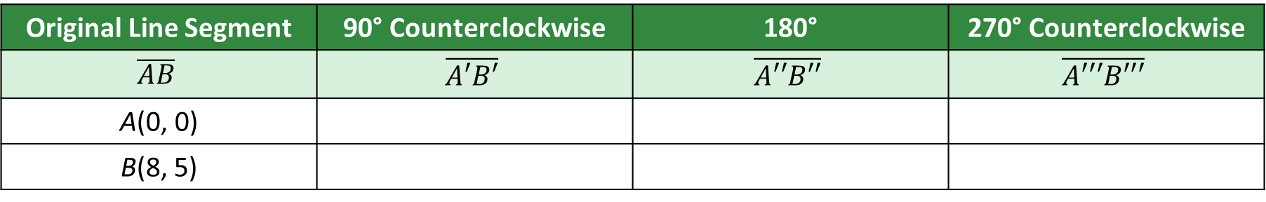
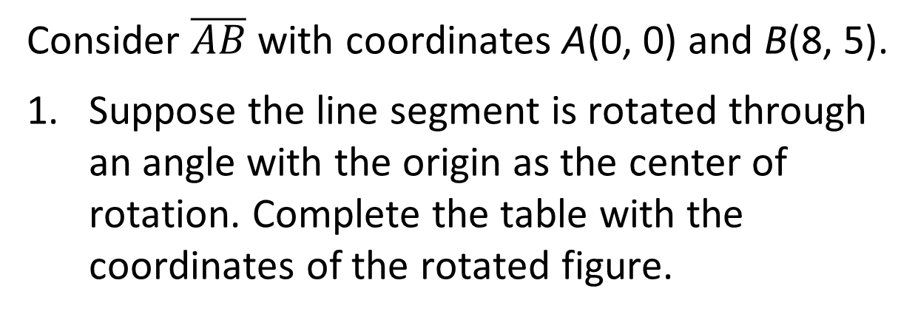
Coordinate Rotation (1 of 5)
Consider $\overline{AB}$ with coordinates A(0, 0) and B(8, 5).
Suppose the line segment is rotated through an angle with the origin as the center of rotation. Complete the table with the coordinates of the rotated figure.
Original Line Segment | 90° Counterclockwise | 180° | 270° Counterclockwise
$$\overline{AB}$$ | $$\overline{A′B′}$$ | $$\overline{A′′B′′}$$ | $$\overline{A′′′B′′′}$$
A(0, 0)
B(8, 5)
A′(0, 0)
A″(0, 0)
A‴(0, 0)
B′(−5, 8)
B″(−8, −5)
B‴(5, −8)
SE p. 306
6
Notes:
Questions to Support Discourse – Probing:
How do you know that your rotations are exactly 90°?
Were you surprised by the locations of each rotated line segment? If so, why?
Why do you think $\overline{AB}$ and $\overline{A′′B′′}$ connect to make a straight line?

Slide 7
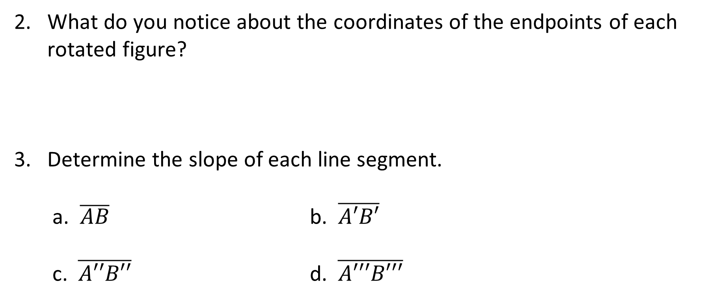
Coordinate Rotation (2 of 5)
What do you notice about the coordinates of the endpoints of each rotated figure?
Determine the slope of each line segment.
a. $\overline{AB}$ b. $\overline{A′B′}$
c. $\overline{A′′B′′}$ d. $\overline{A′′′B′′′}$
Each 90° counterclockwise rotation changes (x, y) to (−y, x): B(8, 5) → B′(−5, 8) → B″(−8, −5) → B‴(5, −8). Endpoint A is the center of rotation, so it does not change.
m = 5/8
m = −8/5
m = 5/8
m = −8/5
SE p. 306
7
Notes:
Questions to Support Discourse – Seeing Structure
How do the endpoints of each line segment compare after any 90° rotation?
How do the numeric components of the coordinates compare? How do the signs compare?
How do the sign changes connect with what you know about the signs used in each quadrant of the coordinate plane?
Does it make a difference in the slope when the negative sign lies in the numerator or denominator of the fraction?
Which segments have the same slope? How can you tell from the graph?
Questions to Support Discourse – Probing
What two statements could you use to describe the difference in slopes of consecutive line segments?

Slide 8
Coordinate Rotation (3 of 5)
Review the definition of describe in the Academic Glossary.
4. Describe any patterns you notice in the slopes of the figures.
AB and A″B″ (0° and 180°) have equal slopes, 5/8. A′B′ and A‴B‴ (90° and 270°) have equal slopes, −8/5. The two slopes are reciprocals with opposite signs: (5/8)(−8/5) = −1.
SE p. 306
8
Notes:
Questions to Support Discourse – Seeing Structure
How do the endpoints of each line segment compare after any 90° rotation?
How do the numeric components of the coordinates compare? How do the signs compare?
How do the sign changes connect with what you know about the signs used in each quadrant of the coordinate plane?
Does it make a difference in the slope when the negative sign lies in the numerator or denominator of the fraction?
Which segments have the same slope? How can you tell from the graph?
Questions to Support Discourse – Probing
What two statements could you use to describe the difference in slopes of consecutive line segments?

Slide 9

Coordinate Rotation (4 of 5)
Let’s summarize our learning from the Getting Started!
SE p. 306
9
Notes:
Getting Started Summary:
A point (x, y) that is rotated 90° counterclockwise has the coordinates (−y, x).

Slide 10
Coordinate Rotation (5 of 5)
SE p. 306
10
Notes:
Note: This slide is blank for optional use with displaying work.

Slide 11
Activity 3.1
★ Essential activity: do not skip
3.1
20–25
11
Notes:
Note: Total time of 20-25 minutes allotted for Activity 3.1.

Slide 12
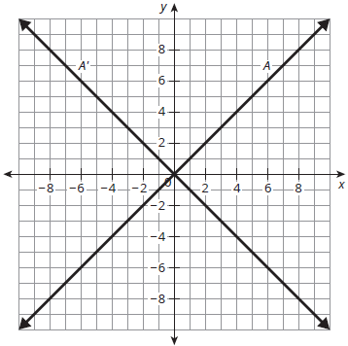
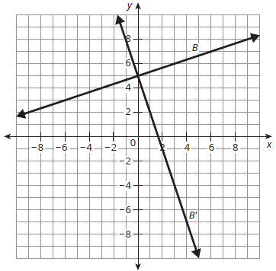
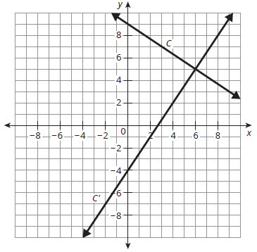
Slopes of Perpendicular Lines (1 of 9)
Recall that perpendicular lines or line segments form a right angle at the point of intersection.
Consider the three graphs shown. Each shows a line and its rotation 90° about a point, which is also the point of intersection.
★ Essential · SE p. 307
12

Slide 13
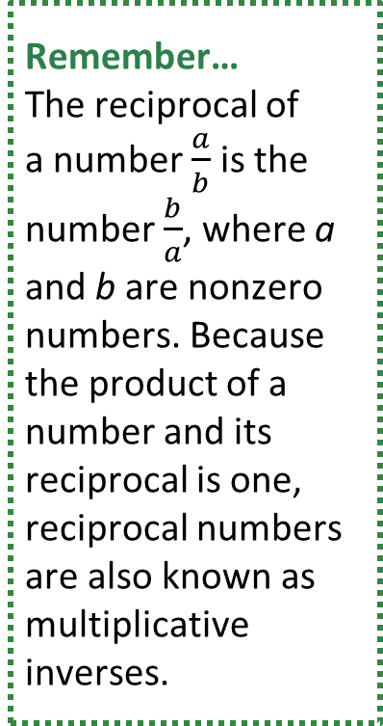
Slopes of Perpendicular Lines (2 of 9)
Are the lines in each graph perpendicular? Explain your reasoning.
Write the equation for each line and its transformation. What do you notice?
Remember…
The reciprocal of
a number $\frac{a}{b}$ is the number $\frac{b}{a}$, where a and b are nonzero numbers. Because the product of a number and its reciprocal is one, reciprocal numbers are also known as multiplicative inverses.
Yes. Each line is rotated 90°, so the lines meet at a 90° angle, a right angle. Lines that form right angles are perpendicular.
A: y = x; A′: y = −x
B: y = (1/3)x + 5; B′: y = −3x + 5
C: y = −(2/3)x + 9; C′: y = (3/2)x − 4
The slopes of each pair are reciprocals with opposite signs.
★ Essential · SE p. 307
13
Notes:
Questions to Support Discourse – Probing:
Why does this specific rotation create perpendicular lines?
Questions to Support Discourse – Seeing Structure:
How could you use patty paper to verify that the lines are perpendicular?
Questions to Support Discourse – Probing:
What strategy did you use to write the equation of each line?
Questions to Support Discourse – Seeing Structure:
What is the relationship between the slopes?
Is there any relationship between perpendicular lines and their y-intercepts?
Why can’t you use these equations to prove perpendicular lines have reciprocal slopes with opposite signs?

Slide 14

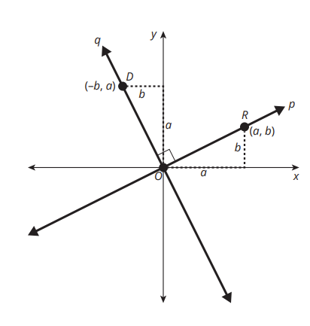
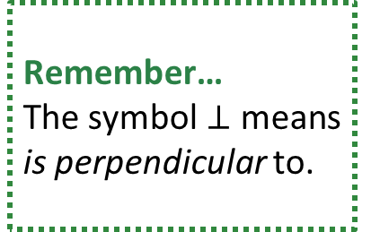
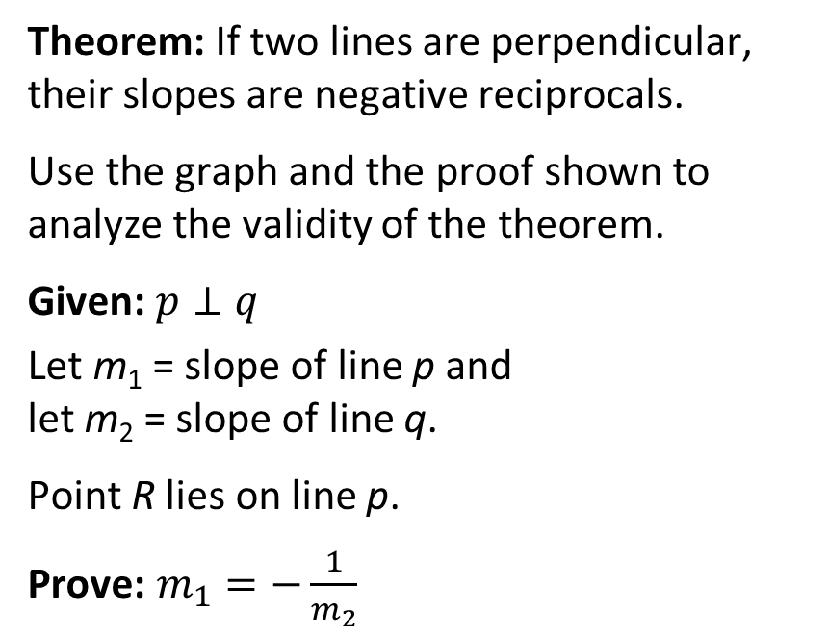
Slopes of Perpendicular Lines (3 of 9)
Consider the theorem.
Theorem: If two lines are perpendicular, their slopes are negative reciprocals.
Use the graph and the proof shown to analyze the validity of the theorem.
Given: $p⊥q$
Let m₁ = slope of line p and
let m₂ = slope of line q.
Point R lies on line p.
Prove: $m_{1}=−\frac{1}{m_{2}}$
Remember…
The symbol $⊥$ means is perpendicular to.
The product of
the slopes of perpendicular lines is −1.
★ Essential · SE p. 308
14
Notes:
Questions to Support Discourse – Gathering:
How does the Assumption statement relate to the If Then statement? The Conclusion statement?
What is meant by negative reciprocals?
Explain what the conclusion $m_{1}=−\frac{1}{m_{2}}$ means.
Does the negative sign mean the second line always has a negative slope? Explain your thinking.
Questions to Support Discourse – Probing:
Explain why the coordinates of point D are (−b, a).
Explain how the side lengths of each triangle were determined.
How can you use the labeled diagram to determine each slope?
Explain the steps to rewrite the complex fraction.
Questions to Support Discourse – Seeing Structure:
Why does the Worked Example demonstrate formal reasoning?
Questions to Support Discourse – Probing:
How did you determine the negative reciprocal of −3?

Slide 15
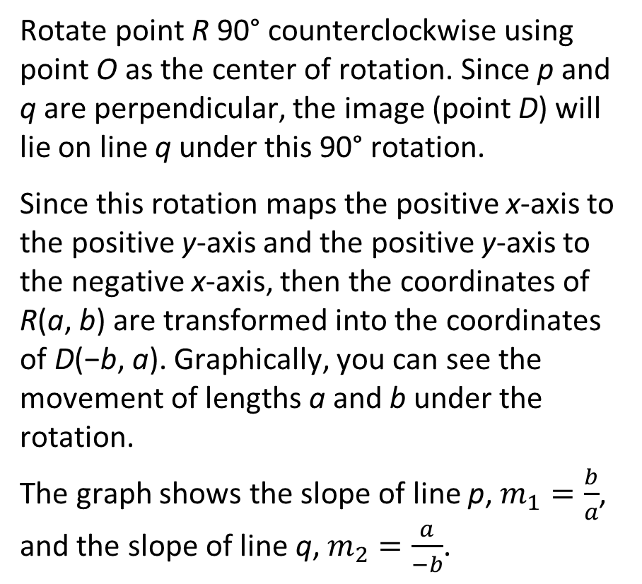
Slopes of Perpendicular Lines (4 of 9)
Rotate point R 90° counterclockwise using point O as the center of rotation. Since p and q are perpendicular, the image (point D) will lie on line q under this 90° rotation.
Since this rotation maps the positive x-axis to the positive y-axis and the positive y-axis to the negative x-axis, then the coordinates of R(a, b) are transformed into the coordinates of D(−b, a). Graphically, you can see the movement of lengths a and b under the rotation.
The graph shows the slope of line p, $m_{1}=\frac{b}{a}$, and the slope of line q, $m_{2}=\frac{a}{−b}$.
The proof shown is
a paragraph proof. You will learn different formats
of proof as you investigate more
properties of lines and figures.
★ Essential · SE p. 308
15
Notes:
Questions to Support Discourse – Gathering:
How does the Assumption statement relate to the If Then statement? The Conclusion statement?
What is meant by negative reciprocals?
Explain what the conclusion $m_{1}=−\frac{1}{m_{2}}$ means.
Does the negative sign mean the second line always has a negative slope? Explain your thinking.
Questions to Support Discourse – Probing:
Explain why the coordinates of point D are (−b, a).
Explain how the side lengths of each triangle were determined.
How can you use the labeled diagram to determine each slope?
Explain the steps to rewrite the complex fraction.
Questions to Support Discourse – Seeing Structure:
Why does the Worked Example demonstrate formal reasoning?
Questions to Support Discourse – Probing:
How did you determine the negative reciprocal of −3?

Slide 16
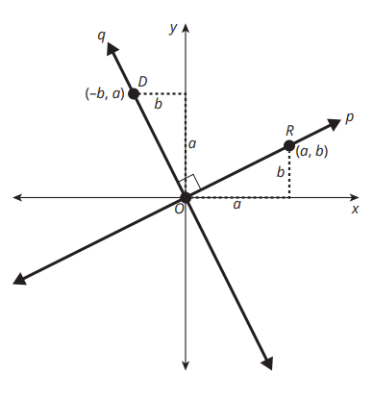
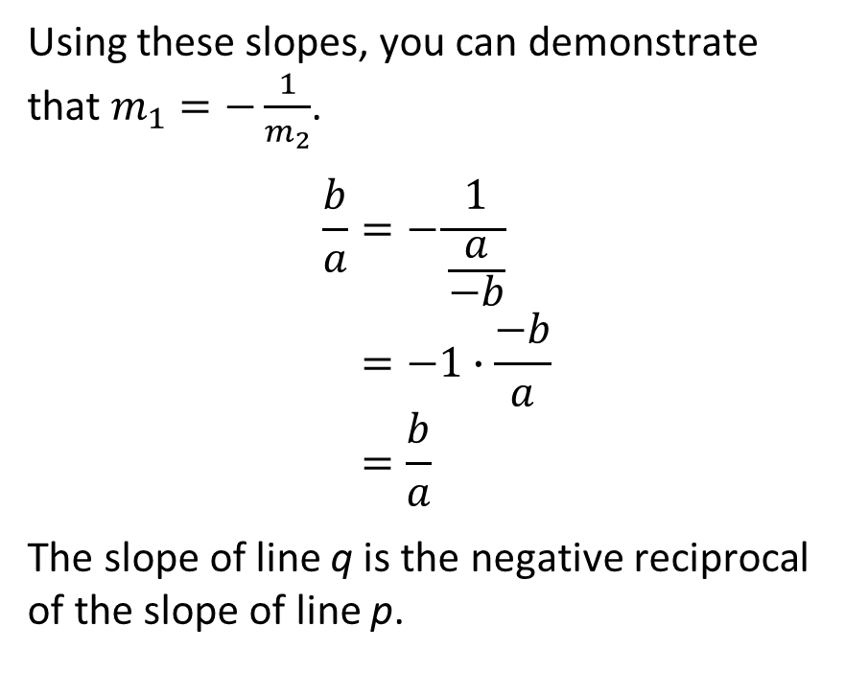
Slopes of Perpendicular Lines (5 of 9)
Using these slopes, you can demonstrate that $m_{1}=−\frac{1}{m_{2}}$.
$$\frac{b}{a}=−\frac{1}{\frac{a}{−b}} \\ =−1∙\frac{−b}{a} \\ =\frac{b}{a}$$
The slope of line q is the negative reciprocal of the slope of line p.
★ Essential · SE p. 308
16
Notes:
Questions to Support Discourse – Gathering:
How does the Assumption statement relate to the If Then statement? The Conclusion statement?
What is meant by negative reciprocals?
Explain what the conclusion $m_{1}=−\frac{1}{m_{2}}$ means.
Does the negative sign mean the second line always has a negative slope? Explain your thinking.
Questions to Support Discourse – Probing:
Explain why the coordinates of point D are (−b, a).
Explain how the side lengths of each triangle were determined.
How can you use the labeled diagram to determine each slope?
Explain the steps to rewrite the complex fraction.
Questions to Support Discourse – Seeing Structure:
Why does the Worked Example demonstrate formal reasoning?
Questions to Support Discourse – Probing:
How did you determine the negative reciprocal of −3?

Slide 17
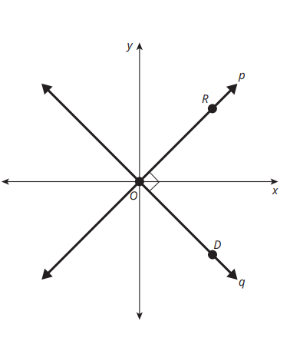
Slopes of Perpendicular Lines (6 of 9)
There is often more than one way to prove a theorem. Suppose that point R is rotated 90° clockwise using point O as the center of rotation.
Rewrite the proof using the clockwise rotation of point R.
Rotating R(a, b) 90° clockwise about O maps it onto line q at D(b, −a).
Slope of p: m1 = b/a. Slope of q: m2 = −a/b.
−1/m2 = −1 ÷ (−a/b) = −1 · (b/−a) = b/a = m1, so m1 = −1/m2.
The slopes are negative reciprocals.
★ Essential · SE p. 309
17
Notes:
Questions to Support Discourse – Gathering:
How does the Assumption statement relate to the If Then statement? The Conclusion statement?
What is meant by negative reciprocals?
Explain what the conclusion $m_{1}=−\frac{1}{m_{2}}$ means.
Does the negative sign mean the second line always has a negative slope? Explain your thinking.
Questions to Support Discourse – Probing:
Explain why the coordinates of point D are (−b, a).
Explain how the side lengths of each triangle were determined.
How can you use the labeled diagram to determine each slope?
Explain the steps to rewrite the complex fraction.
Questions to Support Discourse – Seeing Structure:
Why does the Worked Example demonstrate formal reasoning?
Questions to Support Discourse – Probing:
How did you determine the negative reciprocal of −3?

Slide 18
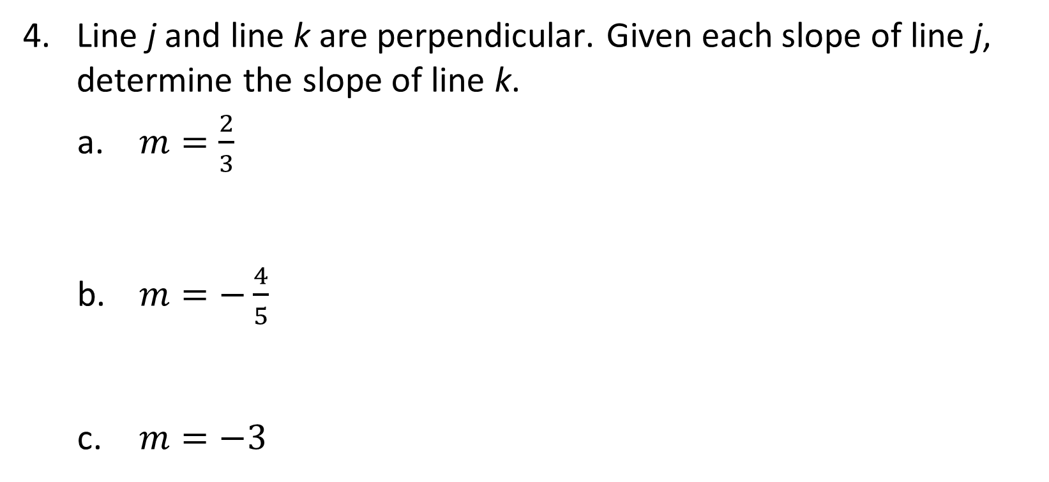
Slopes of Perpendicular Lines (7 of 9)
Line j and line k are perpendicular. Given each slope of line j, determine the slope of line k.
  $m=\frac{2}{3}$
  $m=−\frac{4}{5}$
  $m=−3$
m = −3/2
m = 5/4
m = 1/3
★ Essential · SE p. 309
18
Notes:
Questions to Support Discourse – Gathering:
How does the Assumption statement relate to the If Then statement? The Conclusion statement?
What is meant by negative reciprocals?
Explain what the conclusion $m_{1}=−\frac{1}{m_{2}}$ means.
Does the negative sign mean the second line always has a negative slope? Explain your thinking.
Questions to Support Discourse – Probing:
Explain why the coordinates of point D are (−b, a).
Explain how the side lengths of each triangle were determined.
How can you use the labeled diagram to determine each slope?
Explain the steps to rewrite the complex fraction.
Questions to Support Discourse – Seeing Structure:
Why does the Worked Example demonstrate formal reasoning?
Questions to Support Discourse – Probing:
How did you determine the negative reciprocal of −3?

Slide 19
Slopes of Perpendicular Lines (8 of 9)
Let’s revisit the Essential Question and summarize our learning from Activity 3.1!
Essential Question: How can you rotate the graphs of linear equations to determine the slopes of perpendicular lines?
★ Essential · SE p. 309
19
Notes:
Note: To close Day 1, have students reread the Essential Question and then read the Stamp the Learning summary aloud.
Activity 3.1 Summary:
If two lines are perpendicular, their slopes are negative reciprocals.

Slide 20
Slopes of Perpendicular Lines (9 of 9)
★ Essential · SE p. 309
20
Notes:
Note: This slide is blank for optional use with displaying work.

Slide 21
Day 2
2
21
Notes:
Note: Total suggested pacing for Day 2 is 45 minutes.

Slide 22
Essential Question (2 of 2)
How can you rotate the graphs of linear equations to determine the slopes of perpendicular lines?
Rotating a line 90° about a point maps (x, y) to (−y, x), so a slope b/a becomes −a/b. The slopes of perpendicular lines are negative reciprocals (their product is −1). Any vertical line is perpendicular to any horizontal line.
SE p. 305
22
Notes:
Note: To begin Day 2, have a student read the Essential Question aloud.

Slide 23
Activity 3.2
★ Essential activity: do not skip
3.2
15–20
23
Notes:
Note: Total time of 15-20 minutes allotted for Activity 3.2.

Slide 24
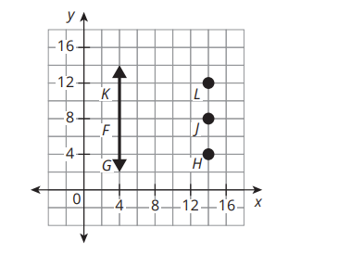
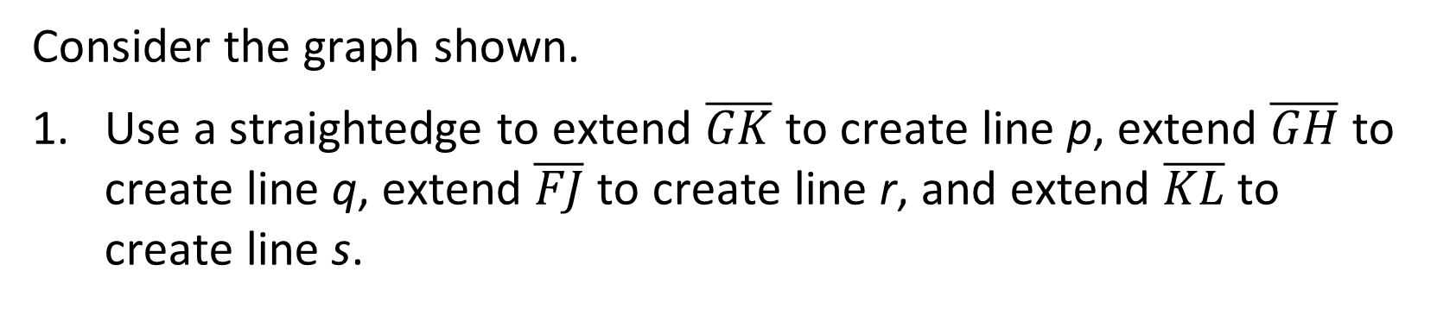
Horizontal and Vertical Lines (1 of 7)
Consider the graph shown.
Use a straightedge to extend $\overline{GK}$ to create line p, extend $\overline{GH}$ to create line q, extend $\overline{FJ}$ to create line r, and extend $\overline{KL}$ to create line s.
Line p is the vertical line x = 4.
Lines q, r and s are the horizontal lines y = 4, y = 8 and y = 12.
★ Essential · SE p. 310
24
Notes:
Questions to Support Discourse – Probing:
Demonstrate the slope is zero using two points from a line.
Demonstrate the slope is zero using points (x₁, y₁) and (x₂, y₂).
Questions to Support Discourse – Seeing Structure:
If one line has a slope of zero, how do you know all the other lines have a slope of zero?
Questions to Support Discourse – Probing:
What is another way to demonstrate the slope is undefined?
Read from the graph: G and K are on x = 4; H and G are on y = 4, F and J on y = 8, K and L on y = 12.

Slide 25
Horizontal and Vertical Lines (2 of 7)
Consider the three horizontal lines you drew for Question 1. For any horizontal line, if x increases by one unit, by how many units does y change?
Describe the slope of any horizontal line. Explain your reasoning.
The value of y does not change: it changes by 0 units.
The slope of any horizontal line is 0. The value of y stays the same, so m = (y2 − y1)/(x2 − x1) = 0/(x2 − x1) = 0.
★ Essential · SE p. 310
25
Notes:
Questions to Support Discourse – Probing:
Demonstrate the slope is zero using two points from a line.
Demonstrate the slope is zero using points (x₁, y₁) and (x₂, y₂).
Questions to Support Discourse – Seeing Structure:
If one line has a slope of zero, how do you know all the other lines have a slope of zero?
Questions to Support Discourse – Probing:
What is another way to demonstrate the slope is undefined?

Slide 26
Horizontal and Vertical Lines (3 of 7)
Consider the vertical line you drew in Question 1. Suppose that y increases by one unit. By how many units does x change?
Describe the slope of any vertical line. Explain your reasoning.
The value of x does not change: it changes by 0 units.
The slope of any vertical line is undefined. The value of x stays the same, so m = (y2 − y1)/(x2 − x1) = (y2 − y1)/0, which is undefined.
★ Essential · SE p. 310
26
Notes:
Questions to Support Discourse – Probing:
Demonstrate the slope is zero using two points from a line.
Demonstrate the slope is zero using points (x₁, y₁) and (x₂, y₂).
Questions to Support Discourse – Seeing Structure:
If one line has a slope of zero, how do you know all the other lines have a slope of zero?
Questions to Support Discourse – Probing:
What is another way to demonstrate the slope is undefined?

Slide 27
Horizontal and Vertical Lines (4 of 7)
Determine whether each of the given statements is always, sometimes, or never true. Explain your reasoning.
  All vertical lines are parallel.
  All horizontal lines are parallel.
Describe the relationship between any vertical line and any horizontal line.
Always. All vertical lines have an undefined slope, so they are parallel.
Always. All horizontal lines have slope 0, so they are parallel.
Any vertical line and any horizontal line are always perpendicular.
★ Essential · SE p. 311
27
Notes:
Questions to Support Discourse – Seeing Structure:
How do you know the form of the equation for a horizontal or vertical line?
How can you use a table of values to verify your reasoning? A graph?
Questions to Support Discourse – Probing:
What is the slope of the original line? What is the reciprocal of that slope?
How do you know which number from the ordered pair to use in your equation?
Questions to Support Discourse – Seeing Structure:
Does the relationship that perpendicular lines have negative reciprocal slopes apply to vertical and horizontal lines? Explain your thinking.
Questions to Support Discourse – Reflecting and Justifying
Sketch a graph to verify your thinking.

Slide 28
Horizontal and Vertical Lines (5 of 7)
Write an equation for a horizontal line and an equation for a vertical line that pass through the point (2, −1).
Write an equation for a line that is perpendicular to the line given by x = 5 and passes through the point (1, 0).
Write an equation for a line that is perpendicular to the line given by y = −2 and passes through the point (5, 6).
Horizontal line: y = −1; vertical line: x = 2
y = 0 (a horizontal line through (1, 0))
x = 5 (a vertical line through (5, 6))
★ Essential · SE p. 311
28
Notes:
Questions to Support Discourse – Seeing Structure:
How do you know the form of the equation for a horizontal or vertical line?
How can you use a table of values to verify your reasoning? A graph?
Questions to Support Discourse – Probing:
What is the slope of the original line? What is the reciprocal of that slope?
How do you know which number from the ordered pair to use in your equation?
Questions to Support Discourse – Seeing Structure:
Does the relationship that perpendicular lines have negative reciprocal slopes apply to vertical and horizontal lines? Explain your thinking.
Questions to Support Discourse – Reflecting and Justifying
Sketch a graph to verify your thinking.

Slide 29
Horizontal and Vertical Lines (6 of 7)
Let’s summarize our learning from Activity 3.2!
★ Essential · SE p. 311
29
Notes:
Activity 3.2 Summary:
Any vertical line and any horizontal line are perpendicular to each other.

Slide 30
Horizontal and Vertical Lines (7 of 7)
★ Essential · SE p. 311
30
Notes:
Note: This slide is blank for optional use with displaying work.

Slide 31
Activity 3.3
★ Essential activity: do not skip
3.3
15–20
31
Notes:
Note: Total time of 15-20 minutes allotted for Activity 3.3.

Slide 32
Writing Equations of Perpendicular Lines (1 of 5)
Remember…
You can use point-slope form to write an equation for any line when you know its slope and one point on that line.
In a previous lesson, you wrote the equation of a line parallel to a given line that passes through a given point. You can write the equation of a perpendicular line using what you know about the slope of that line and any point on that line.
Write the equation of the line perpendicular to
y = 2x + 1 that passes through the point (6, 2).
The perpendicular slope is −1/2.
y − 2 = −(1/2)(x − 6)
y − 2 = −(1/2)x + 3
y = −(1/2)x + 5
★ Essential · SE p. 312
32
Notes:
Questions to Support Discourse – Probing:
How did you know what slope to use in your equation?
How did you use the point the line passes through to help write your equation?
Explain how you used the slope formula to write the equation of the line.
How can you check that your answer is correct?
How did you determine the slope to use in your equation without being given a perpendicular slope?
Questions to Support Discourse – Seeing Structure:
How was knowing the point of intersection helpful?
How was the information given in Question 5 similar to the information given in Questions 3 and 4?

Slide 33
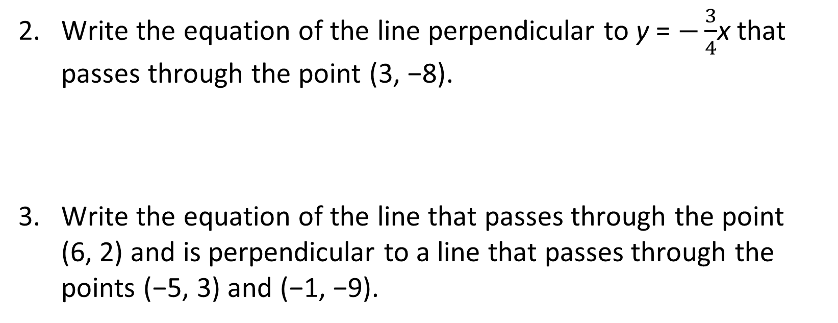
Writing Equations of Perpendicular Lines (2 of 5)
Write the equation of the line perpendicular to y = $−\frac{3}{4}$x that passes through the point (3, −8).
Write the equation of the line that passes through the point
(6, 2) and is perpendicular to a line that passes through the points (−5, 3) and (−1, −9).
The perpendicular slope is 4/3.
y − (−8) = (4/3)(x − 3); y + 8 = (4/3)x − 4; y = (4/3)x − 12
m = (−9 − 3)/(−1 − (−5)) = −12/4 = −3, so the perpendicular slope is 1/3.
y − 2 = (1/3)(x − 6); y − 2 = (1/3)x − 2; y = (1/3)x
★ Essential · SE p. 312
33
Notes:
Questions to Support Discourse – Probing:
How did you know what slope to use in your equation?
How did you use the point the line passes through to help write your equation?
Explain how you used the slope formula to write the equation of the line.
How can you check that your answer is correct?
How did you determine the slope to use in your equation without being given a perpendicular slope?
Questions to Support Discourse – Seeing Structure:
How was knowing the point of intersection helpful?
How was the information given in Question 5 similar to the information given in Questions 3 and 4?
TE wording slip (Q2): the TE says 'a line with a slope of 3/4'; the given line y = −(3/4)x has slope −3/4. The answer y = (4/3)x − 12 is correct. In Q3 to Q5 the TE writes the slope formula as (y2 − y1)/(y2 − y1); the denominator is x2 − x1. Its numbers are correct.

Slide 34
Writing Equations of Perpendicular Lines (3 of 5)
Write the equation of a line that passes through the point
(−2, 7) and is perpendicular to a line that passes through the points (−6, 1) and (0, 4).
A pair of perpendicular lines intersect at the point (5, 9). Write the equation of the line that is perpendicular to the line that also passes through point (−4, 4).
m = (4 − 1)/(0 − (−6)) = 3/6 = 1/2, so the perpendicular slope is −2.
y − 7 = −2(x − (−2)); y − 7 = −2x − 4; y = −2x + 3
m = (4 − 9)/(−4 − 5) = −5/−9 = 5/9, so the perpendicular slope is −9/5.
y − 9 = −(9/5)(x − 5); y − 9 = −(9/5)x + 9; y = −(9/5)x + 18
★ Essential · SE p. 313
34
Notes:
Questions to Support Discourse – Probing:
How did you know what slope to use in your equation?
How did you use the point the line passes through to help write your equation?
Explain how you used the slope formula to write the equation of the line.
How can you check that your answer is correct?
How did you determine the slope to use in your equation without being given a perpendicular slope?
Questions to Support Discourse – Seeing Structure:
How was knowing the point of intersection helpful?
How was the information given in Question 5 similar to the information given in Questions 3 and 4?

Slide 35
Writing Equations of Perpendicular Lines (4 of 5)
Let’s summarize our learning from Activity 3.3!
★ Essential · SE p. 313
35
Notes:
Activity 3.3 Summary:
To write the equation of a line perpendicular to a given line, it is necessary to use the negative reciprocal relationship between their slopes.

Slide 36
Writing Equations of Perpendicular Lines (5 of 5)
★ Essential · SE p. 313
36
Notes:
Note: This slide is blank for optional use with displaying work.

Slide 37
Talk the Talk
5
37
Notes:
Note: Total time of 5 minutes allotted for the Talk the Talk.

Slide 38
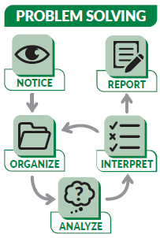
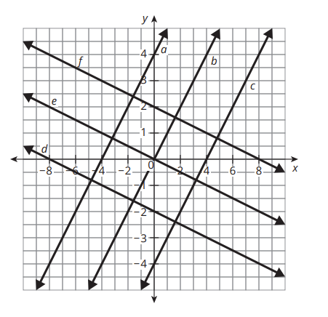
Things Aren’t Always What They Seem (1 of 4)
Consider the graphs of six linear equations shown.
SE p. 314
38

Slide 39

Things Aren’t Always What They Seem (2 of 4)
Linh says lines a, b, and c are parallel
to each other and perpendicular
to lines d, e, and f. Jackson agrees
that lines a, b, and c are parallel to
each other but says they are not perpendicular to lines d, e, and f. Who is correct? Justify your reasoning.
Jackson is correct. The axes have different scales. Lines a, b and c all have slope 1, so they are parallel. Lines d, e and f all have slope −1/4. Since 1 · (−1/4) ≠ −1, the slopes are not negative reciprocals, so the lines are not perpendicular.
SE p. 314
39
Notes:
Questions to Support Discourse – Gathering:
How can algebra be used to determine whether the lines are perpendicular?
How can patty paper be used to determine whether the lines are perpendicular?
Questions to Support Discourse – Probing:
When you know that one line out of a set of parallel lines is not perpendicular to a line out of another set of parallel lines, can you conclude that none of the lines are perpendicular? Why or why not?
The x-axis counts 1 unit per grid square and the y-axis 1 unit per 2 squares, so the lines look perpendicular but are not.

Slide 40
Things Aren’t Always What They Seem (3 of 4)
Let’s answer the Essential Question and summarize our learning from the Talk the Talk!
Essential Question: How can you rotate the graphs of linear equations to determine the slopes of perpendicular lines?
SE p. 314
40
Notes:
Note: To close Day 2, have students read and answer the Essential Question and then read the Stamp the Learning summary aloud.
Essential Question:
Sample answer: The slopes of perpendicular lines are negative reciprocals. Any vertical line is perpendicular to any horizontal line.
Talk the Talk Summary:
The slopes of lines graphed on a coordinate plane must be negative reciprocals in order for the lines to be defined as perpendicular.

Slide 41
Things Aren’t Always What They Seem (4 of 4)
SE p. 314
41
Notes:
Note: This slide is blank for optional use with displaying work.

Slide 42
Teacher Edition notes for this deck
• Activity 3.3 Q2: the TE says the given line has slope 3/4; y = −(3/4)x has slope −3/4. Its answer, y = (4/3)x − 12, is correct.
• Activity 3.3 Q3 to Q5: the TE prints the slope formula as (y2 − y1)/(y2 − y1); the denominator is x2 − x1. The computed slopes are correct.
• Every TE answer was re-solved and is correct, including the Assignment (pp. 315-317) and Prepare.
42

Slide 43
Prepare
43
Notes:
How can you identify whether students are ready for new learning? ​
Depending on available time, you can assign the Prepare section of the Lesson Assignments as homework or as a warm-up to identify students' prior knowledge for the upcoming lesson's activities.

Slide 44
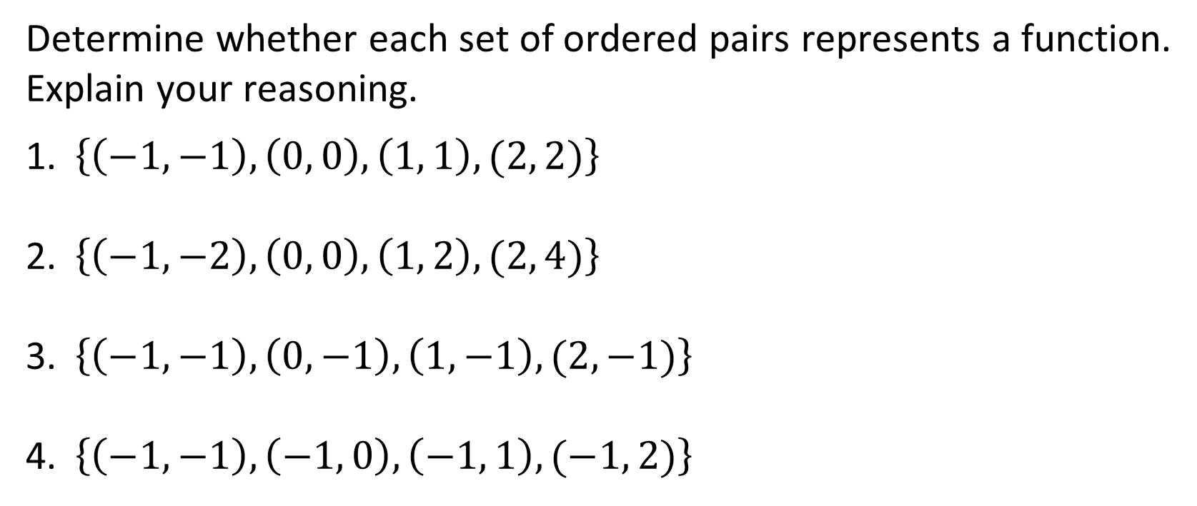
Prepare for Module 2 Topic 2 Lesson 4
Determine whether each set of ordered pairs represents a function.
Explain your reasoning.
$\left\{\left(−1, −1\right), \left(0, 0\right), \left(1, 1\right), (2, 2)\right\}$
$\left\{\left(−1, −2\right), \left(0, 0\right), \left(1, 2\right), (2, 4)\right\}$
$\left\{\left(−1, −1\right), \left(0, −1\right), \left(1, −1\right), (2, −1)\right\}$
$\left\{\left(−1, −1\right), \left(−1, 0\right), \left(−1, 1\right), (−1, 2)\right\}$
Function: each input has exactly one output.
Function: each input has exactly one output.
Function: each input has exactly one output.
Not a function: the input −1 has 4 different outputs.
SE p. 317
44

Slide 45
Acknowledgment and Notice
45

Slide 46
BLMATH_AlgI_M2_T2_L3_DCS_ENG
46

